Slide 1
ONLINE EXAMINATION SYSTEM

Slide 2
About the project
This project is a computerized testing application which involves numerous type of features are as follows :-
Maintains database of the registered students. It contains many Swing components.
Student logins assigning test to the students and generating the report of student’s performance.
Allow them to check there capabilities in courses like Java ,C++, Mathematics, others.
This project keeps all the tracks of registered students and there respective courses.

Slide 3
Panels of the Project

Slide 4
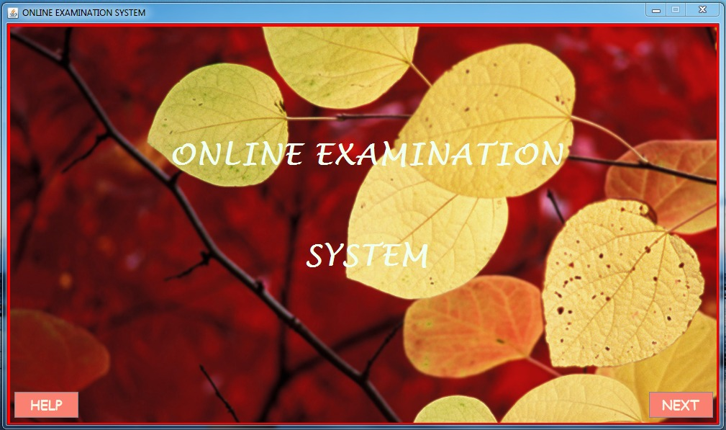
This is our Starting page of our project
It is simple frame in which two buttons are allocated at the bottom corners of this one is HELP and other one is NEXT.

Slide 5
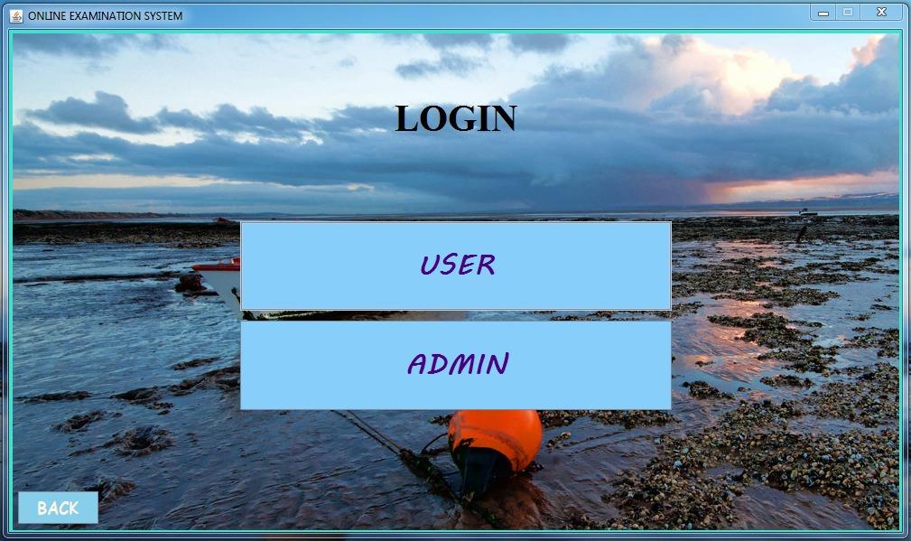
If we chose NEXT button then it will lead you to the Login panel where students and Admin can login and manage the all details which is directly connected to the database .
Where BACK button is for taking again
at the starting page.

Slide 6
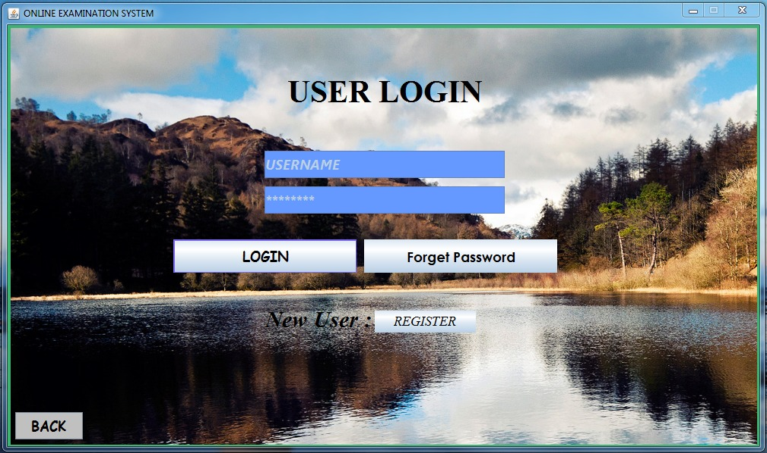
Once the student selected the user login option then he/she is directly go the page of user login where he/she can login or register in this application by pressing respective button and the login details. Here the students can retrieve there password by clicking forget password option.

Slide 7
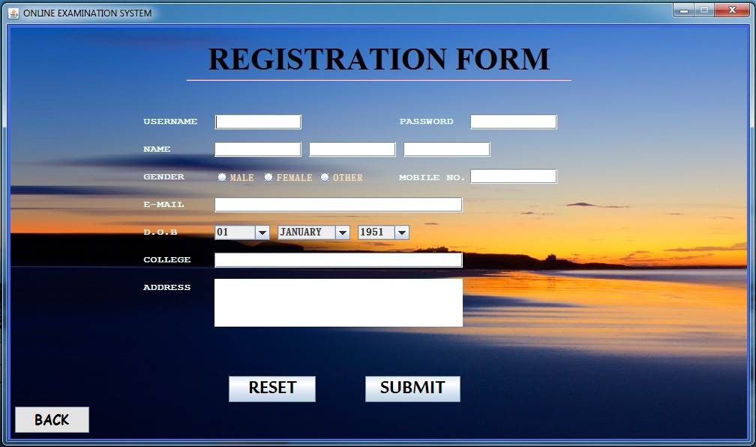
If the student is not registered he/she has to get registered and which will be verified by the admin and data of students is stored at the SQL sever.

Slide 8
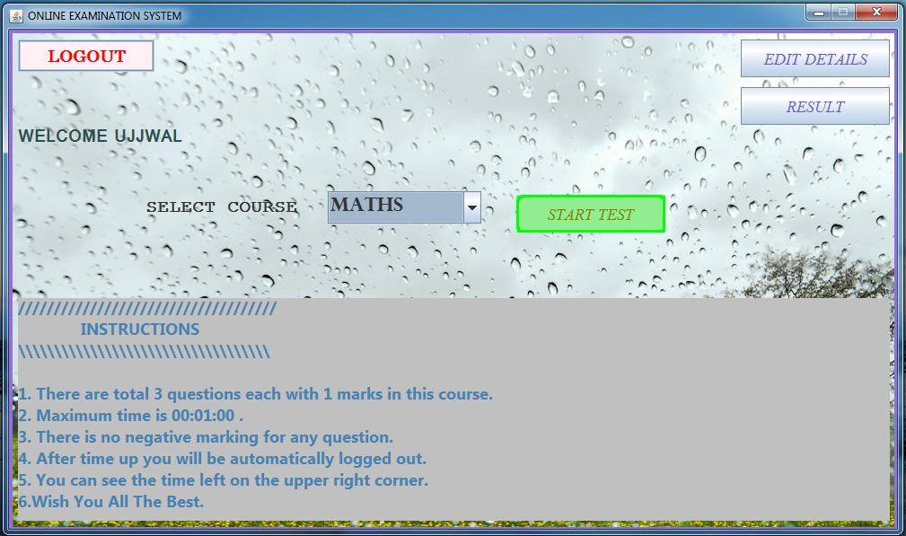
Once the student is logged in then he will come to the selection page where they have to choose subject for exam they have to appear and can edit here particulars by clicking EDIT DETAILS and also can see there result by clicking RESULT.

Slide 9
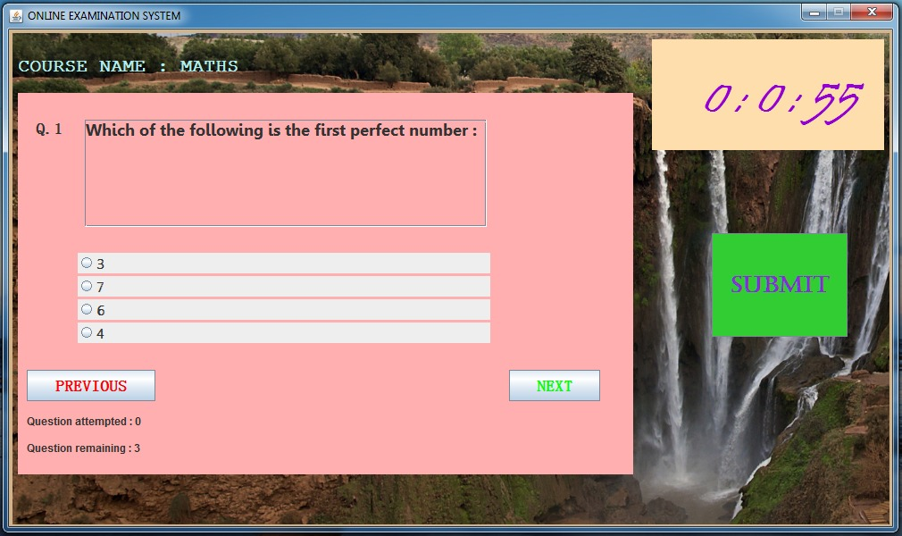
After selecting the course for the test the student can begin there test. It is multiple choice question type test where there is fixed time limit for each course and after completion of test can press SUBMIT and will approach for the RESULT panel.

Slide 10
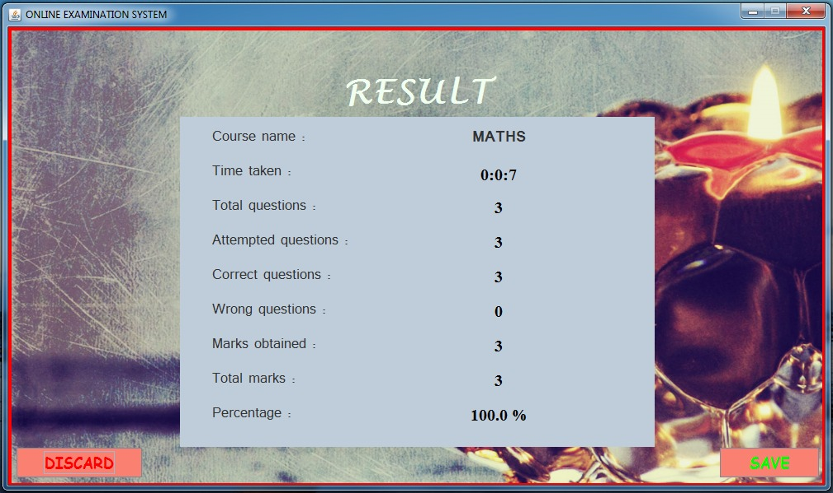
It is the result of particular test in this application which can be saved for future reference or can be discard by the examinee. It can also seen in the USER DETAILS panel.

Slide 11
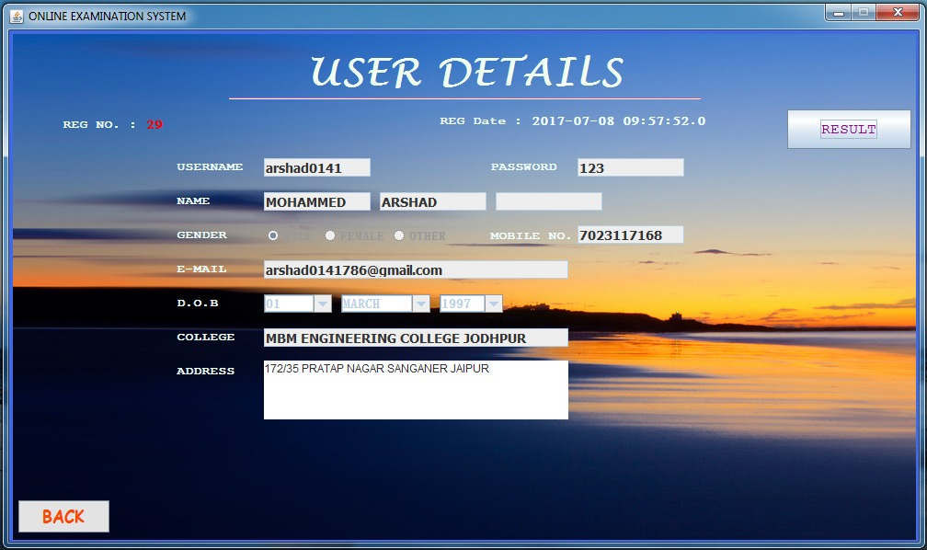
Once they entered there Name ,gender and DOB is submitted and verified successfully then they
cant change these particulars but others details are editable such as username , password and etc.
Which can be saved for the future entries.

Slide 12
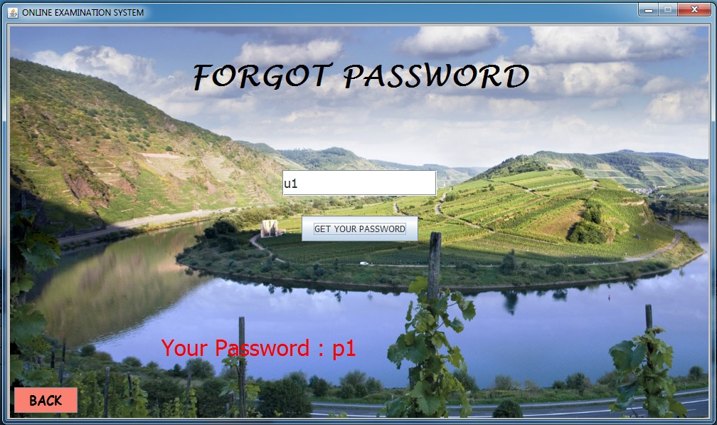
If students forget there password it can gain back just by entering username only in the respective field.

Slide 13
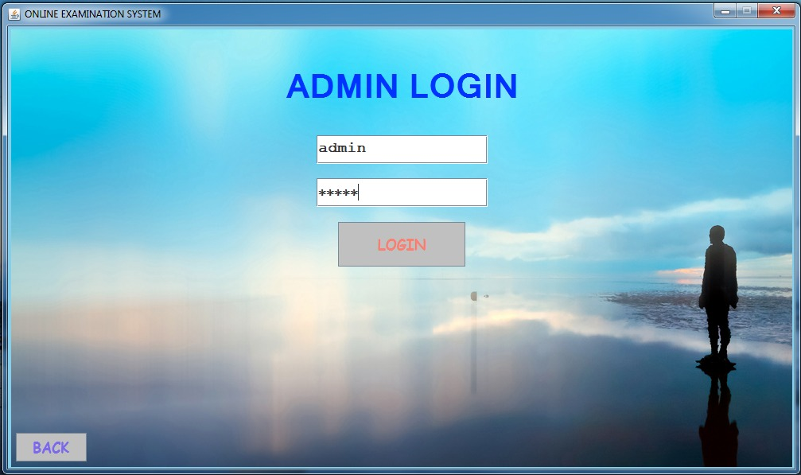
After getting registered in this application the admin will verify the student’s details for this admin have to login from the ADMIN LOGIN by clicking at admin at login page.

Slide 14
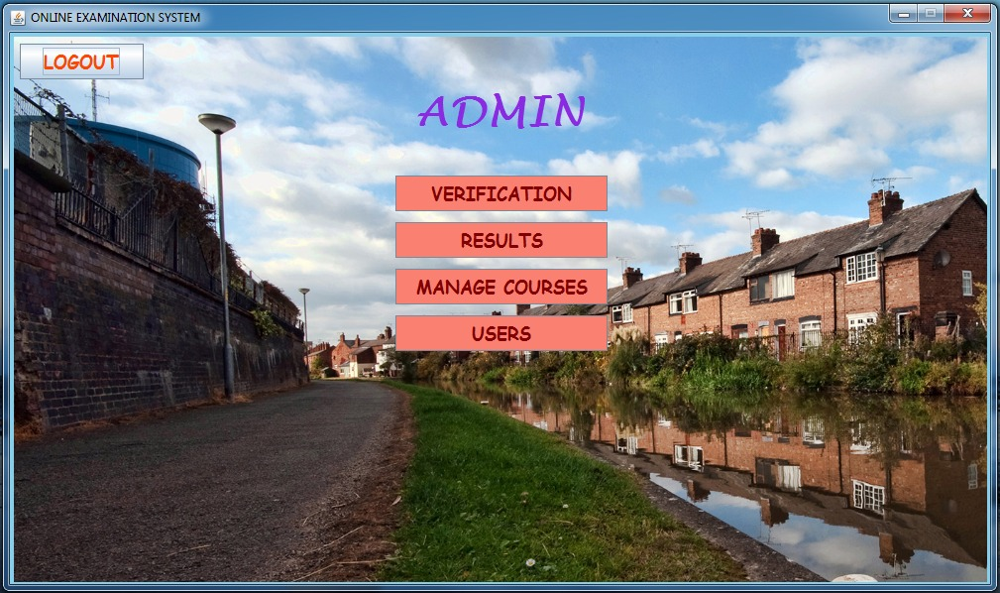
Admin has the power to change everything in this application and manages every details of students and there performance report and of courses.

Slide 15
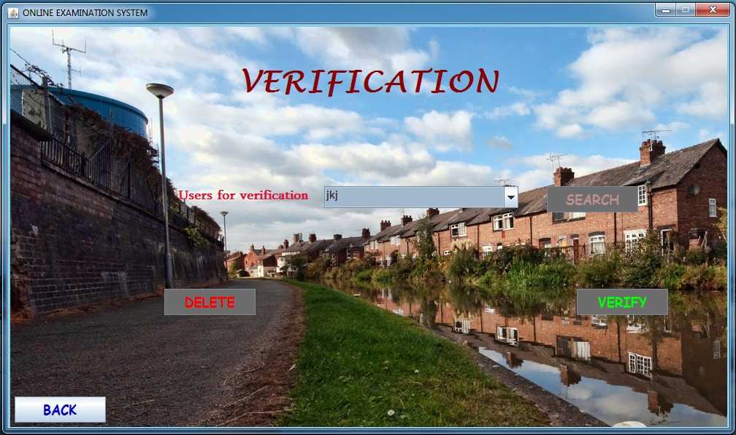
If admin chooses the option verification he/she will come to the verification panel where he verifies the pending users for verification. After which the users can login therafter.

Slide 16
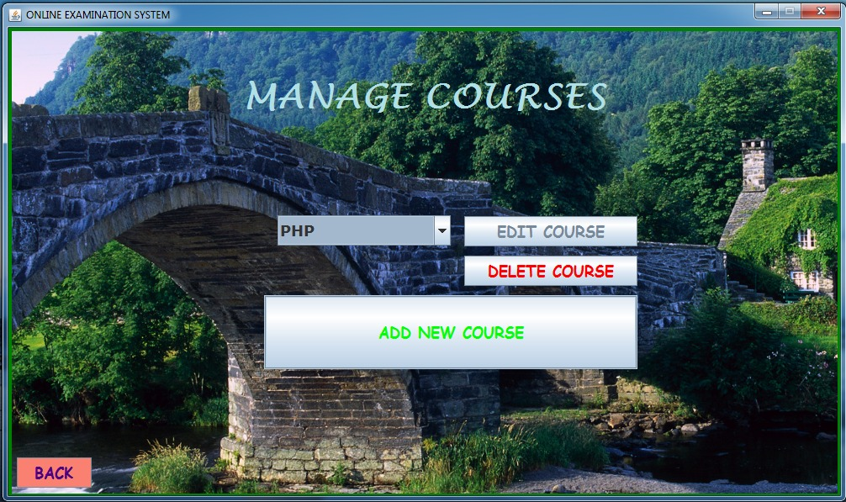
If admin select manage courses there he/she can edit ,delete or add courses as per requirement

Slide 17
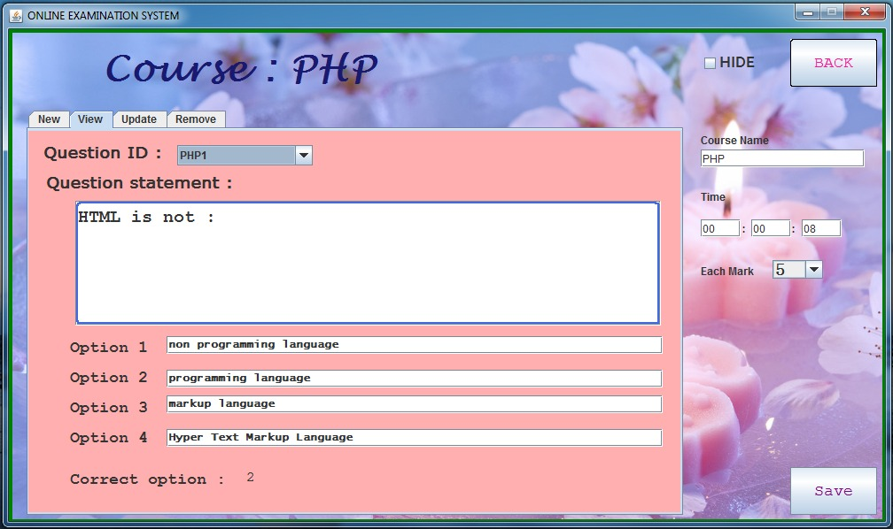
If admin further select course the he /she will enter to the selected course where he/she can view , add, update or remove the questions in the respective course. Here it can be imply hide checkbox which will hide the respective course from user’s list .

Slide 18
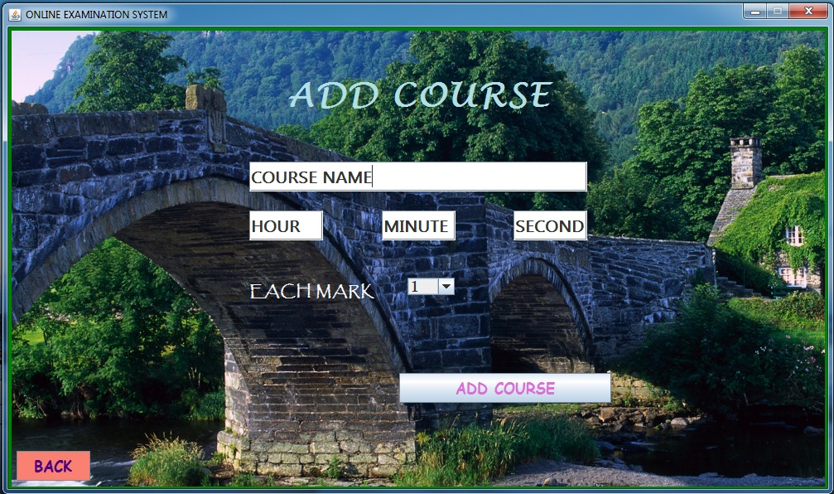
If admin select add courses he will come to the ADD COURSE panel where he can add number of courses as per acknowledgement.

Slide 19
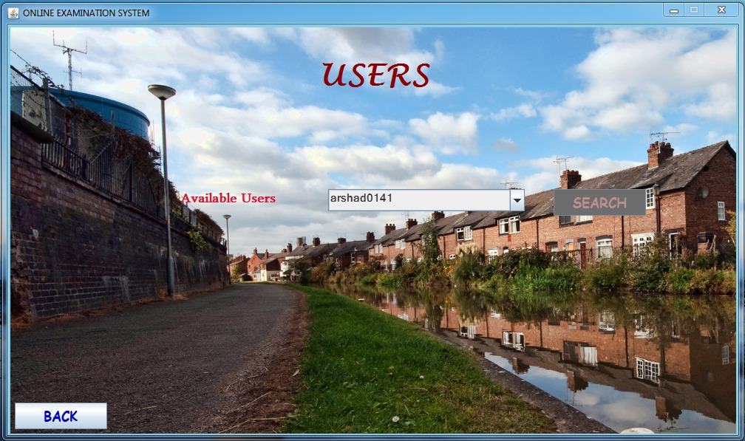
In this application the admin can see each and every user results and can manage it.

Slide 20
THANK YOU
Made by
<Partner 1 Name>
<Partner 2 Name>
In guidance of
<Project manager name>

